Slide 1
The Bone Sparrow
By Zana Fraillon

Slide 2

Cover Analysis
Look closely at the cover of the book.
With the person next to you, come up with a list of 5 things you notice about the cover. This list can include the background, colours, text, or anything else.

Slide 3

Cover Analysis
This is a different cover for the same book.
What are the differences between this cover and the one you have?
What are the similarities?
Does it change what you expect the book to be about?

Slide 4
Asylum Seekers and Refugees
What does the word ‘asylum’ mean to you?
What do you think of when you hear the term ‘asylum seeker’?
What does the word ‘refugee’ mean?
Take a minute to write down what you think, then discuss what you wrote with the person next to you

Slide 5
Asylum Seekers and Refugees
Asylum is the protection granted by a state to someone who has left their home country as a political refugee.
An asylum seeker is someone who has left their home country as a political refugee and is seeking asylum in another.
A refugee is someone who has been forced to leave their home country to escape war, persecution, or natural disaster.

Slide 6
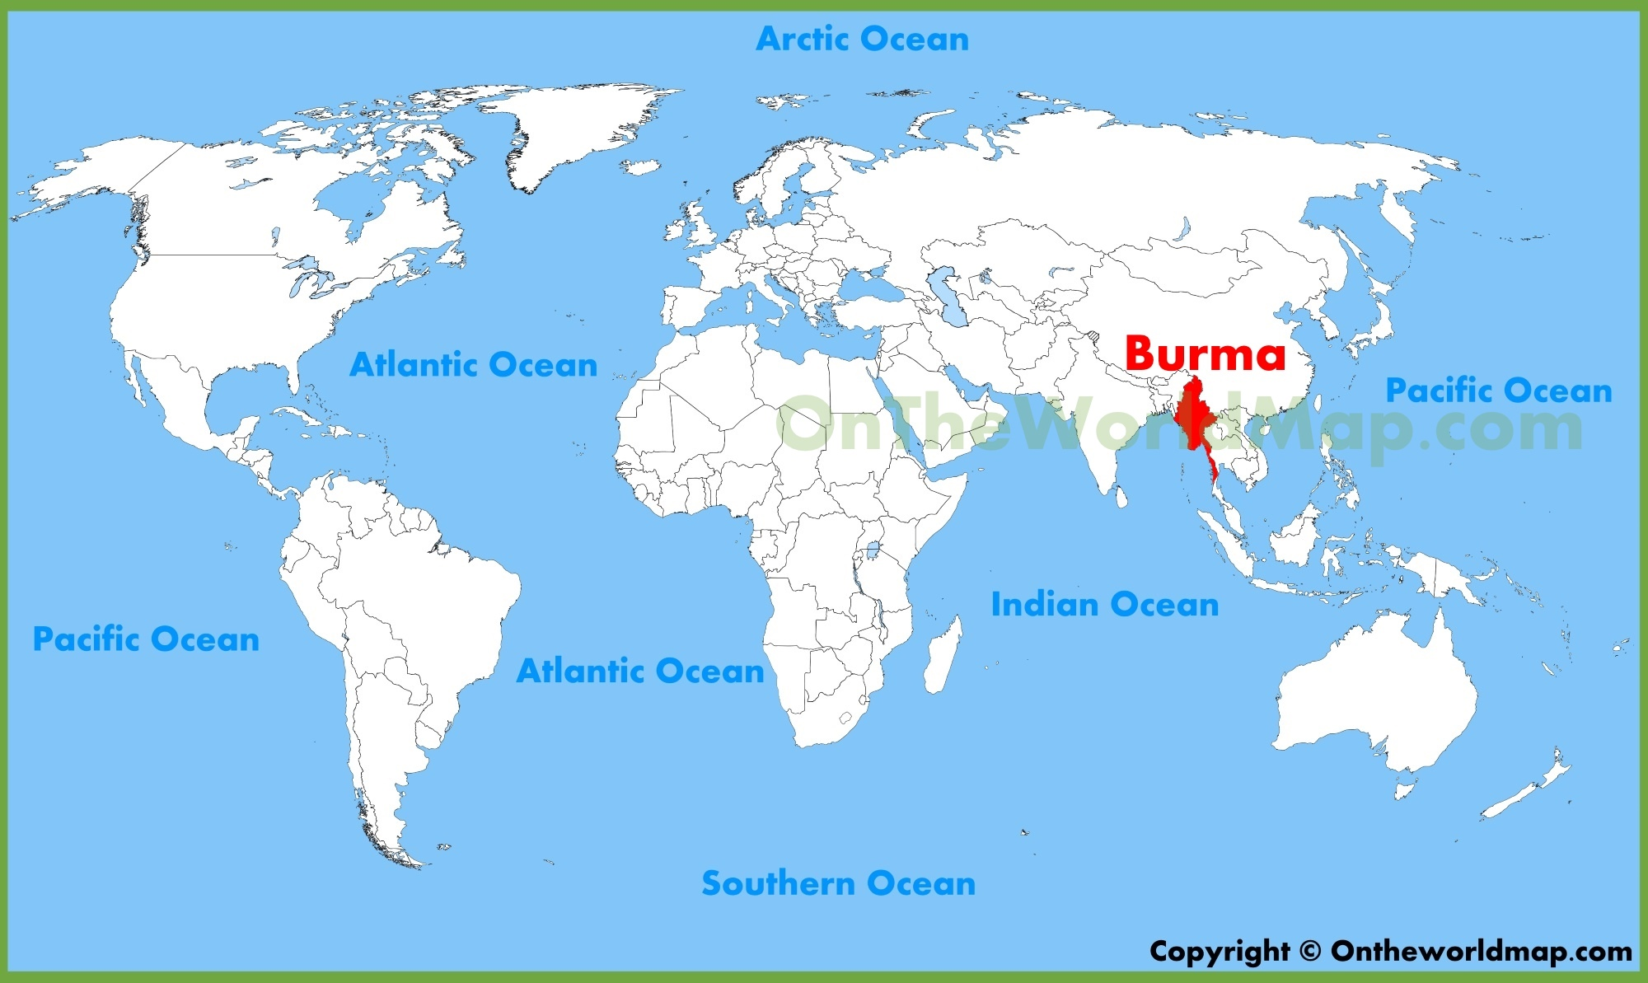
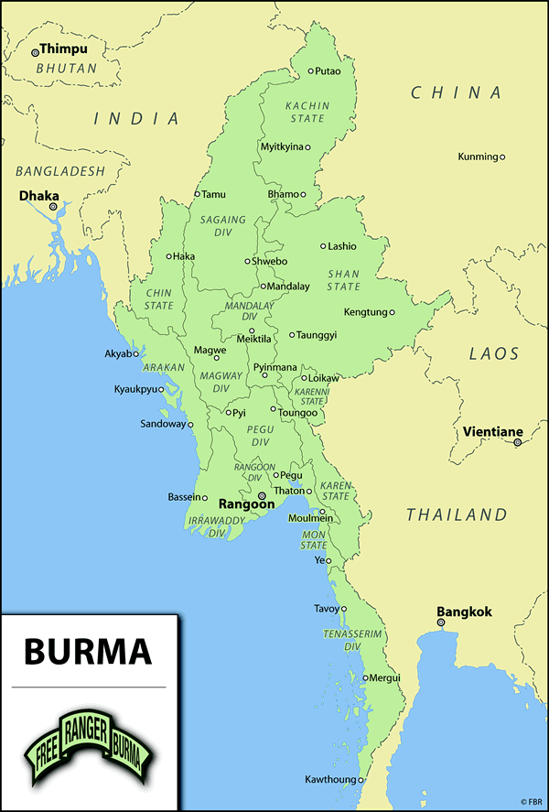
Where is Burma?

Slide 7

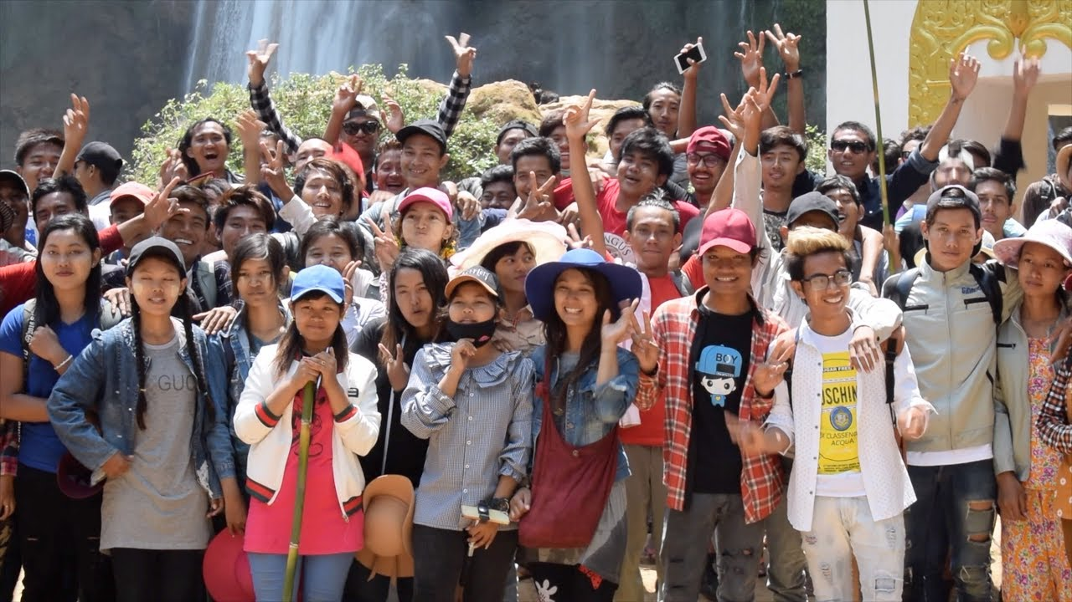
Burma

Slide 8
Rohingya Refugees
https://www.amnesty.org.au/who-are-the-rohingya-refugees/
Since 2017, more than 740,000 people from Myanmar have fled to Bangladesh and elsewhere because of extreme violence on the country’s western Bay of Bengal coast.
Most of the refugees identify as Rohingya, a Muslim minority ethnic group in predominantly Myanmar, which is predominantly Buddhist.

Slide 9
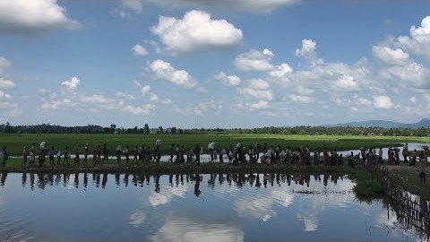
Rohingya Refugees

Slide 10
After Reading Chapter 1
What do we know about Subhi’s family?

